Slide 1
Data Analytics & Data Science - Big Data Platforms
Joy Chakraborty
jchakrabort5@bloomberg.net
Bloomberg L.P.
November 7, 2016
Copyright 2016 Bloomberg L.P. All rights reserved.

Slide 2

Speaker Bio
I am a Distributed System Architect, 15+ years of Software development experience and 10+ years of experience in designing, architecting and developing Distributed systems with a special interest in distributed/parallel computing, currently working on Cloud and Big Data technologies. Also, I actively participate in various Software architectural organization.
I am currently working in Bloomberg’s Data Platform & Warehouse team as Data Engineer since 2014. My responsibility is to store and process petabytes of data reliably, predictably and securely.
Copyright 2016 Bloomberg L.P. All rights reserved.

Slide 3

Agenda
1
Why Data Platform?
2
Big-data
3
Bloomberg’s Big-Data Platform
4
Challenges
5
Question/Answers
Copyright 2016 Bloomberg L.P. All rights reserved.

Slide 4
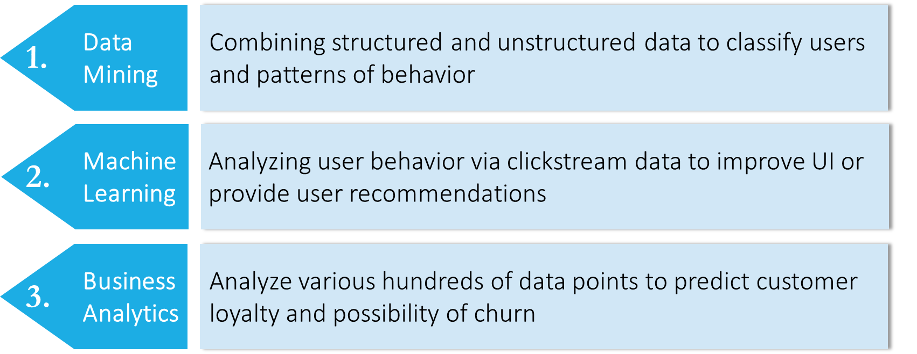
Use Cases -
Source: www.hortonworks.com/use-cases
Copyright 2016 Bloomberg L.P. All rights reserved.

Slide 5
Mission Statement
Create Distributed Data platform to –
Ingest various data sources across the organization
Store data at most granular level in consistent format
Provide tooling to Data Science communities across organization to perform Data-exploration, Analysis & Machine learning activities
Copyright 2016 Bloomberg L.P. All rights reserved.

Slide 6
Business Drivers
Data Security
Data Accessibility
API
SDK
Report/Query
Data Availability
Data Reliability
Data Scalability
Data Usability
Data Maintenance
Copyright 2016 Bloomberg L.P. All rights reserved.

Slide 7
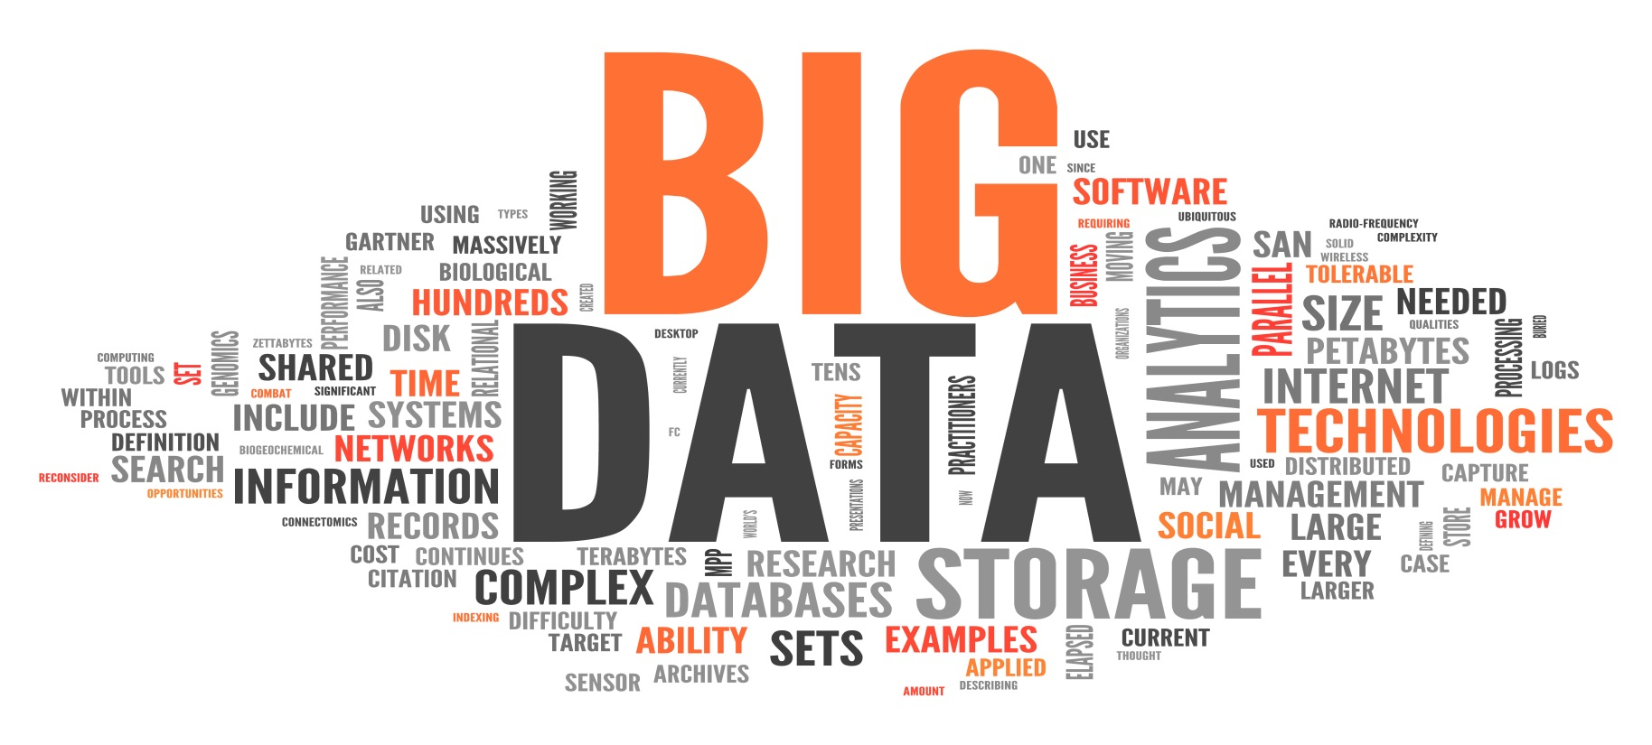
What is Big Data?
Source: Image from http://allterrain.net/blog/how-we-use-big-data-to-create-customer-experiences/
Copyright 2016 Bloomberg L.P. All rights reserved.

Slide 8
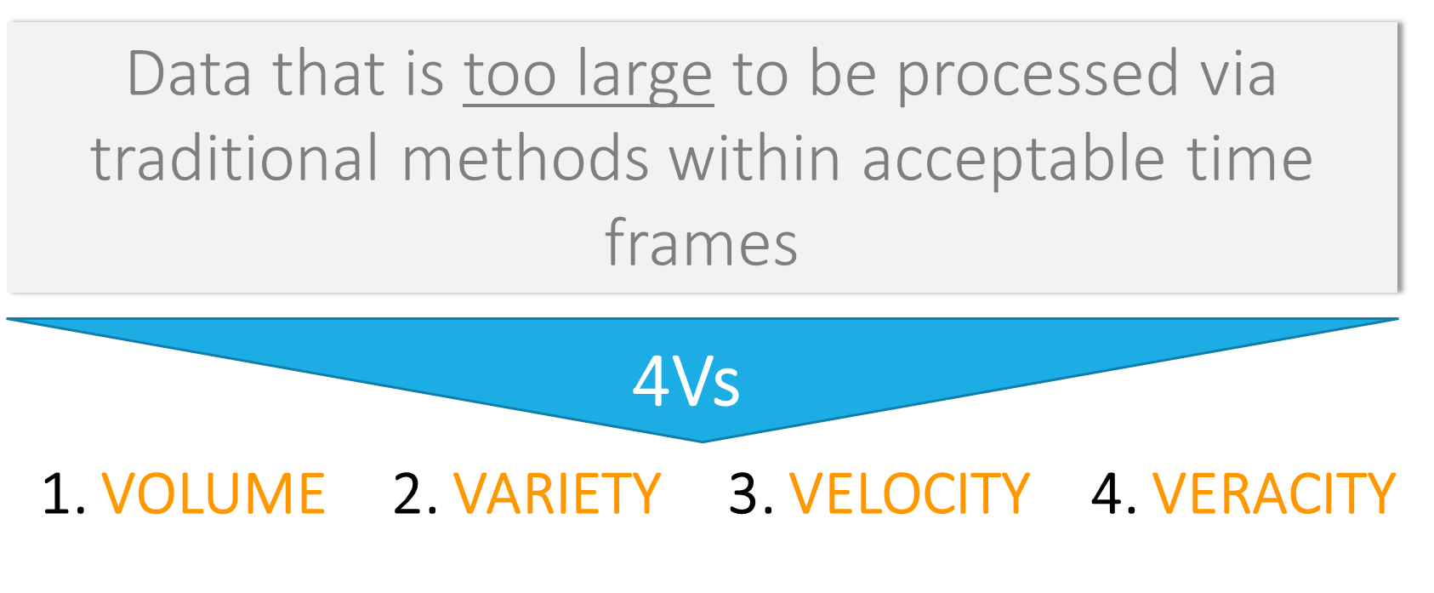
Big Data
Source: www.ibmbigdatahub.com/infographic/four-vs-big-data
Copyright 2016 Bloomberg L.P. All rights reserved.

Slide 9

Hadoop + Traditional methods
Traditional
Single
Monolithic
Expensive
Distributed
Scaling Out
Commodity
Source: http://www.datameer.com/technology/hadoop.html
Copyright 2016 Bloomberg L.P. All rights reserved.

Slide 10
Hadoop’s HDFS is a fault-tolerant distributed file system
Hadoop Distributed File System (HDFS)
Commodity hardware (typically running Linux)
NameNode (master): Job tracker
DataNode (slave): Stores data and performs tasks
Local (vs SAN) storage
Data replicated 3 times for high fault tolerance
About 1/10th cost even after replication
Source: www.hadoop.apache.org
Copyright 2016 Bloomberg L.P. All rights reserved.

Slide 11
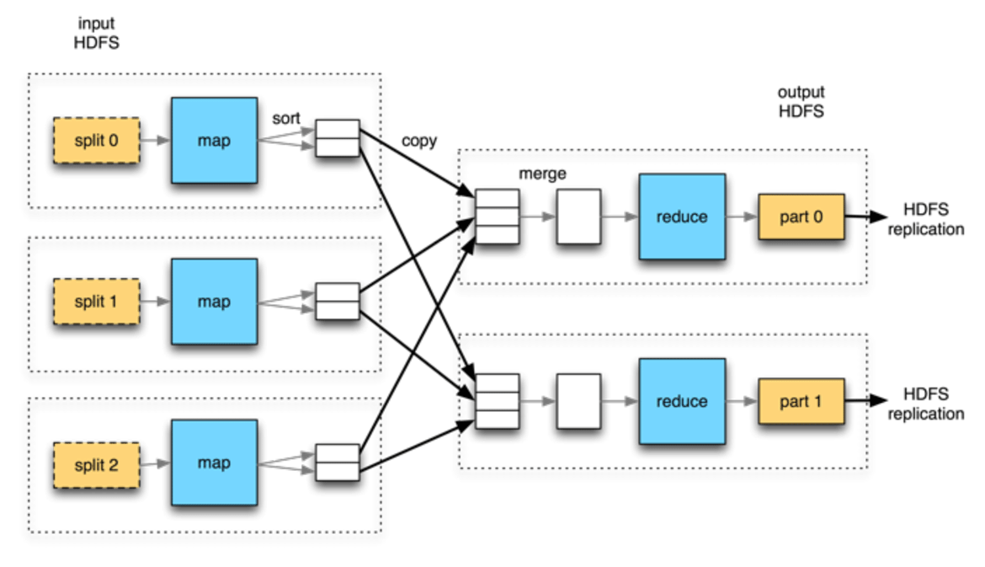
Hadoop leverages Map-Reduce, an open source software framework
MapReduce processes large amounts of data across a collection of servers known as HDFS
MapReduce is easily parallelizable, scales linearly and is highly optimized for analytical workloads
Source: http://www.drdobbs.com/database/hadoop-the-lay-of-the-land/240150854
Copyright 2016 Bloomberg L.P. All rights reserved.

Slide 12
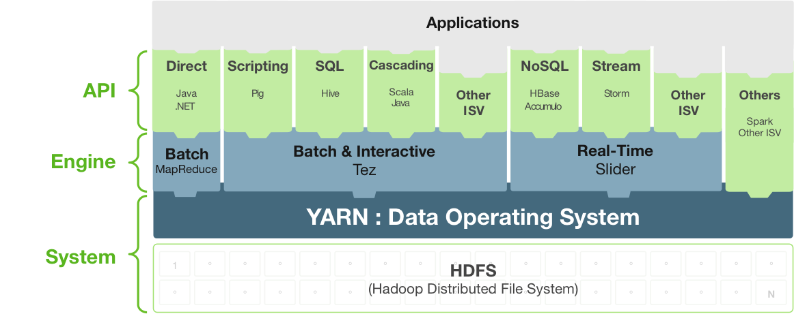
Moving beyond Map-Reduce with Hadoop
Source: http://hortonworks.com/get-started/yarn/
Copyright 2016 Bloomberg L.P. All rights reserved.

Slide 13
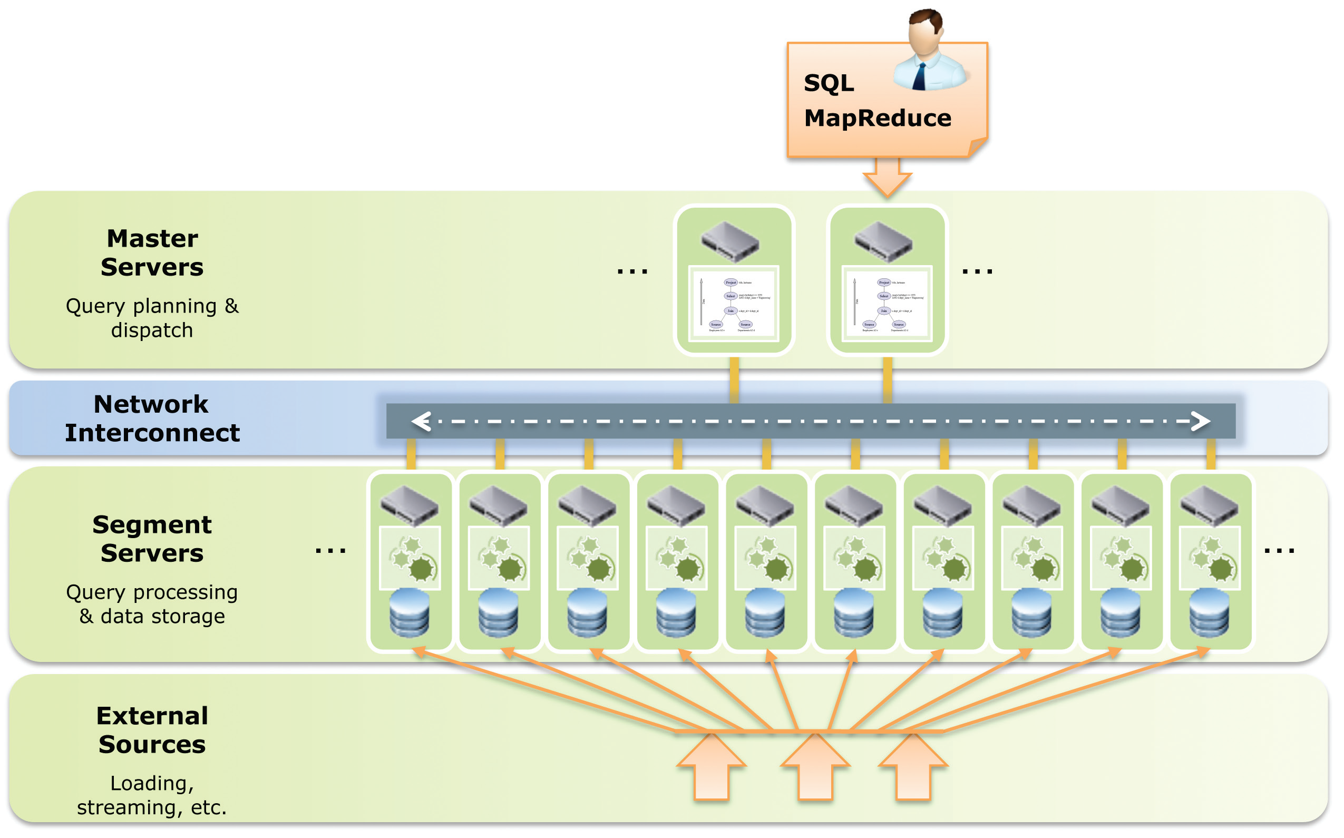
GreenPlum DCA Overview
GP V2
12 segment servers, 6 segments/server
96 segments, 192 Cores, 3TB RAM
81 TB Raw, 400 TB w/ Compression
PostgreSQL
Linear Scale, Parallel Loading
Self-Healing Fault-Tolerance
40GB/sec Scan, 10TB/hr Load
UDF’s: R,Java,C,Python,Perl
ODBC,JDBC,OLEDB BI/ETL Tools
Copyright 2016 Bloomberg L.P. All rights reserved.

Slide 14
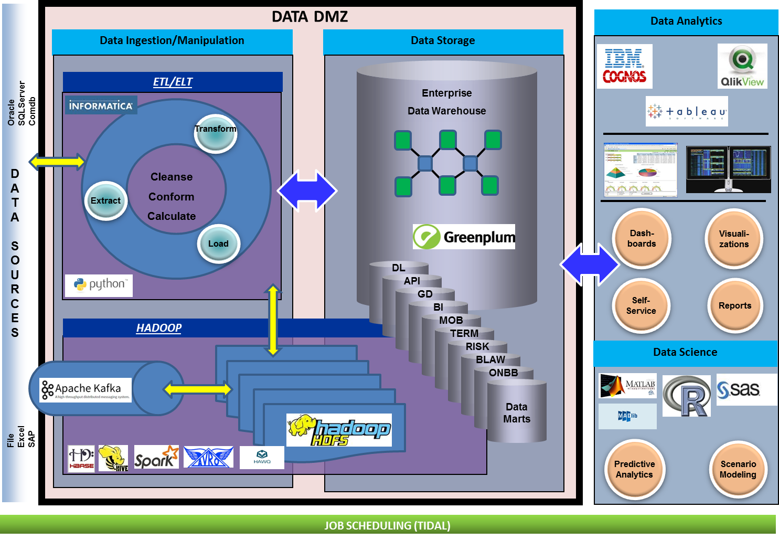
Data Platform – Technology Stack
Copyright 2016 Bloomberg L.P. All rights reserved.

Slide 15
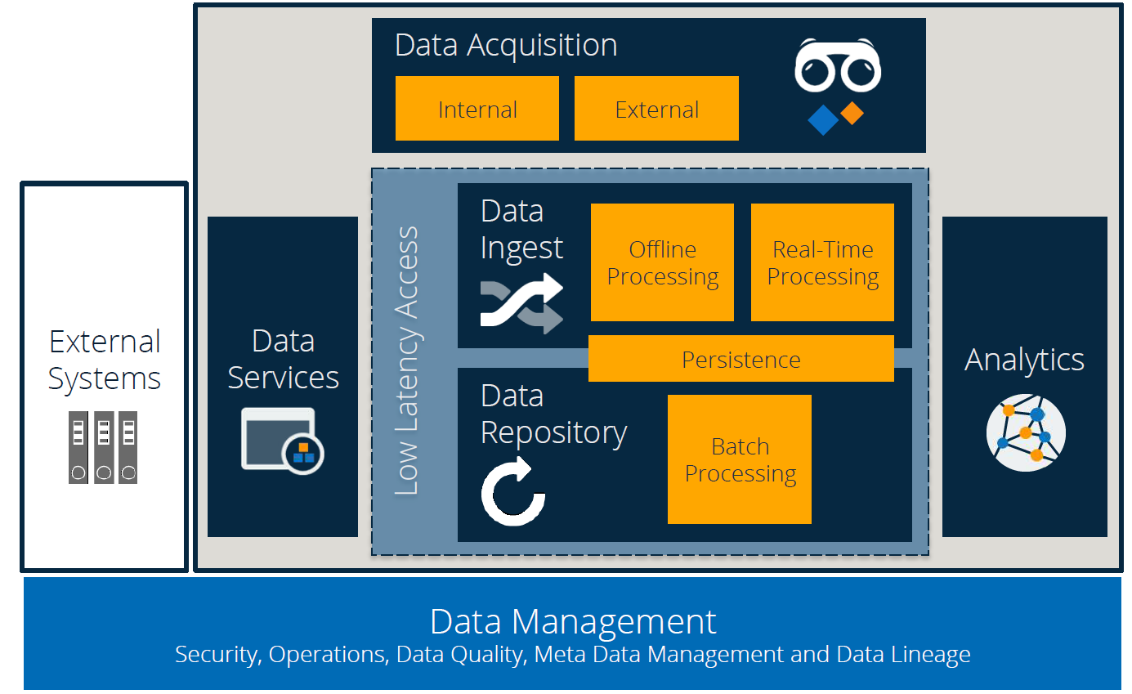
Data Platform Architecture
Copyright 2016 Bloomberg L.P. All rights reserved.

Slide 16
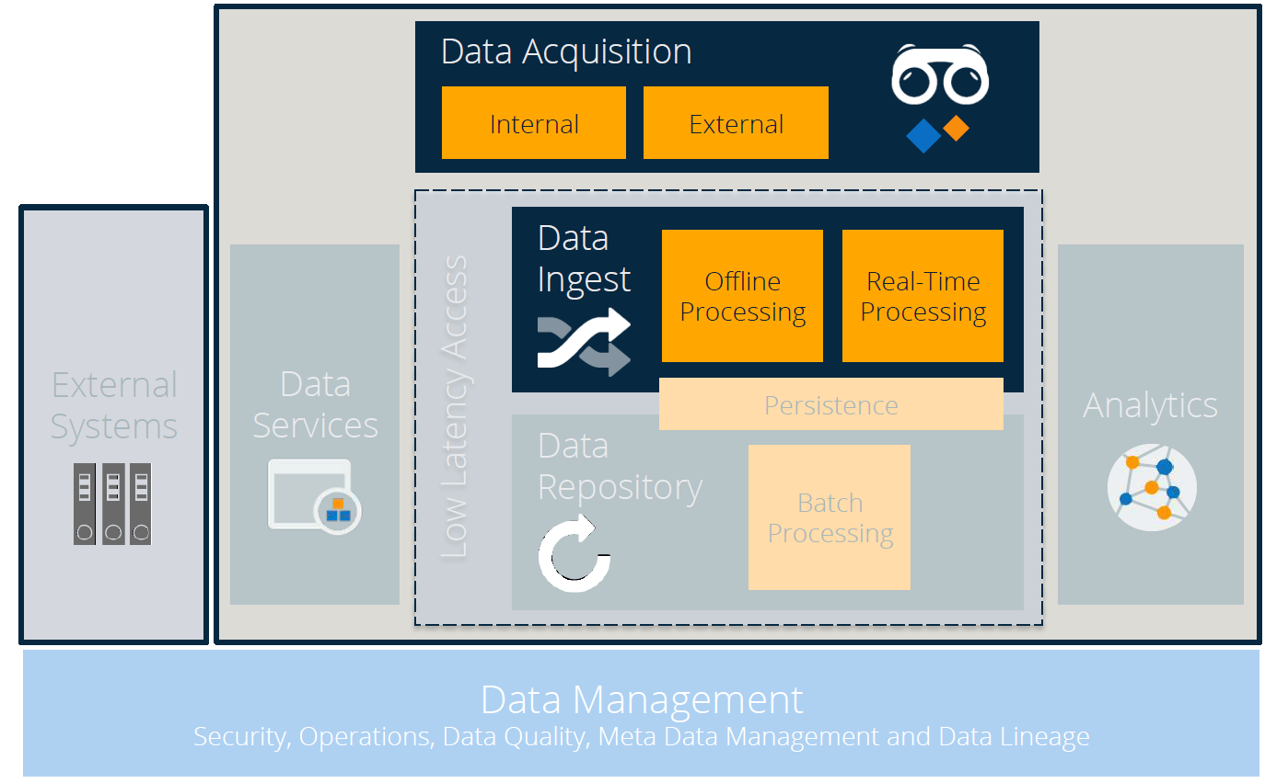
Data Platform - Ingestion
Copyright 2016 Bloomberg L.P. All rights reserved.

Slide 17
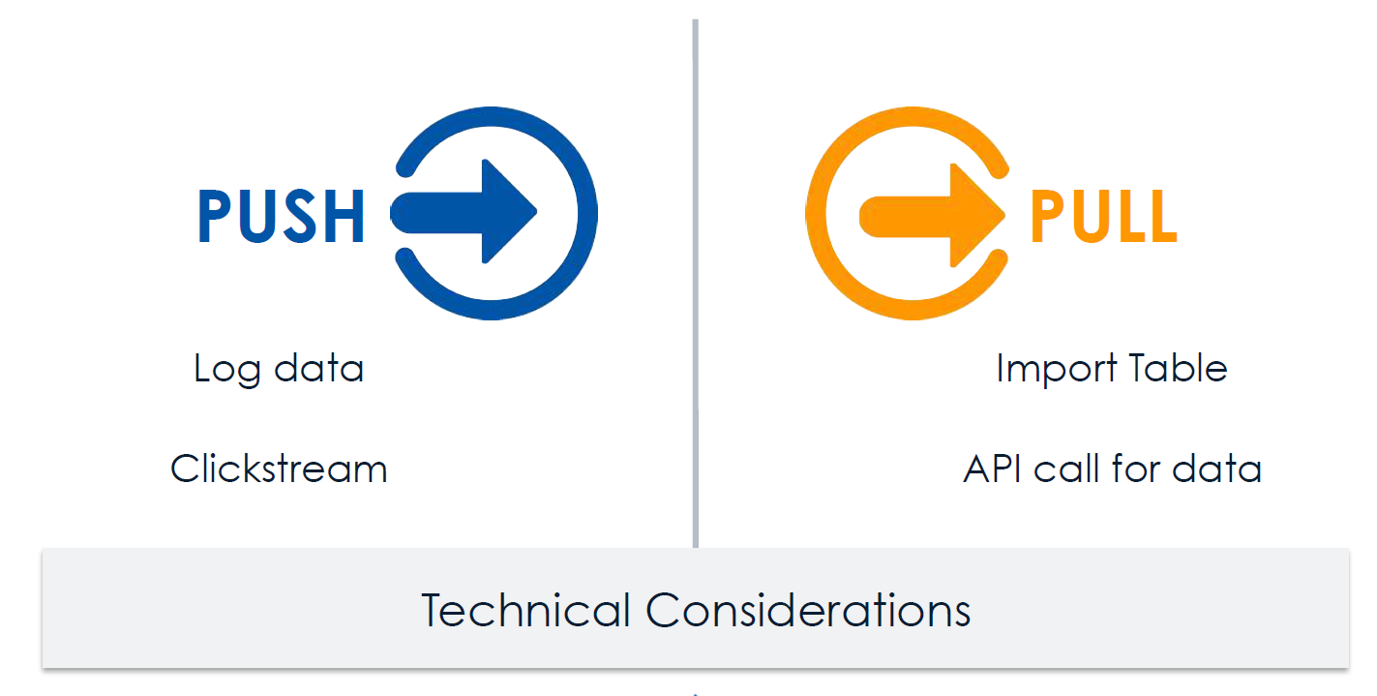
Ingestion Patterns
Copyright 2016 Bloomberg L.P. All rights reserved.

Slide 18
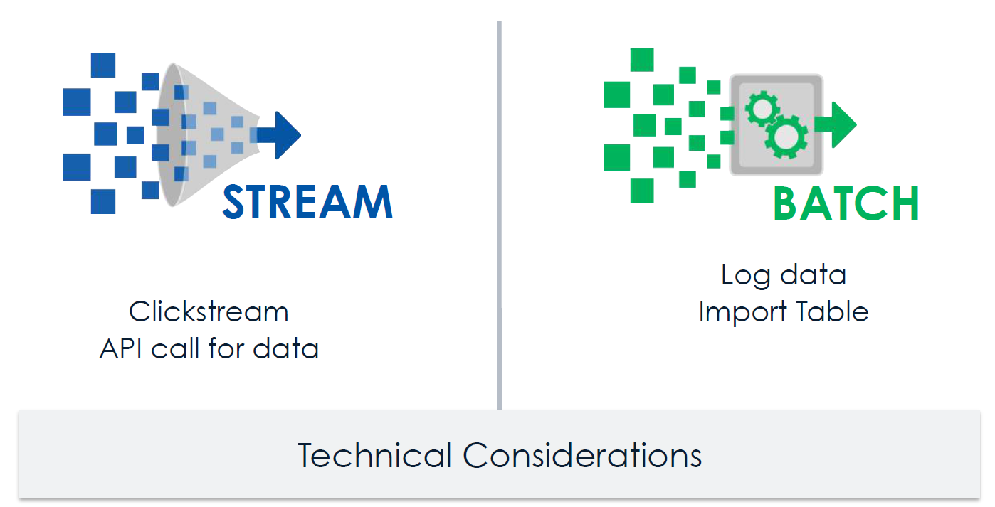
Ingestion - Modes
Copyright 2016 Bloomberg L.P. All rights reserved.

Slide 19
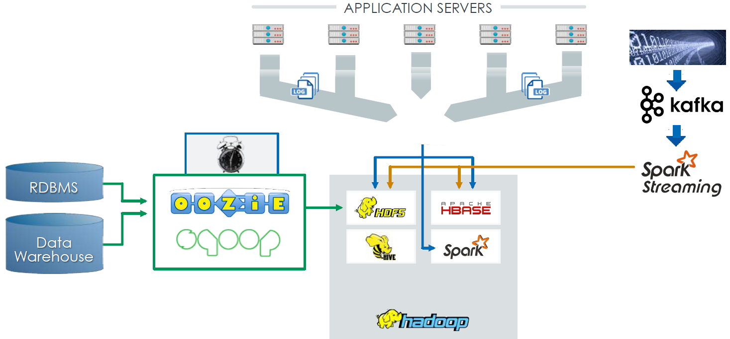
Ingestion - Design
Copyright 2016 Bloomberg L.P. All rights reserved.

Slide 20
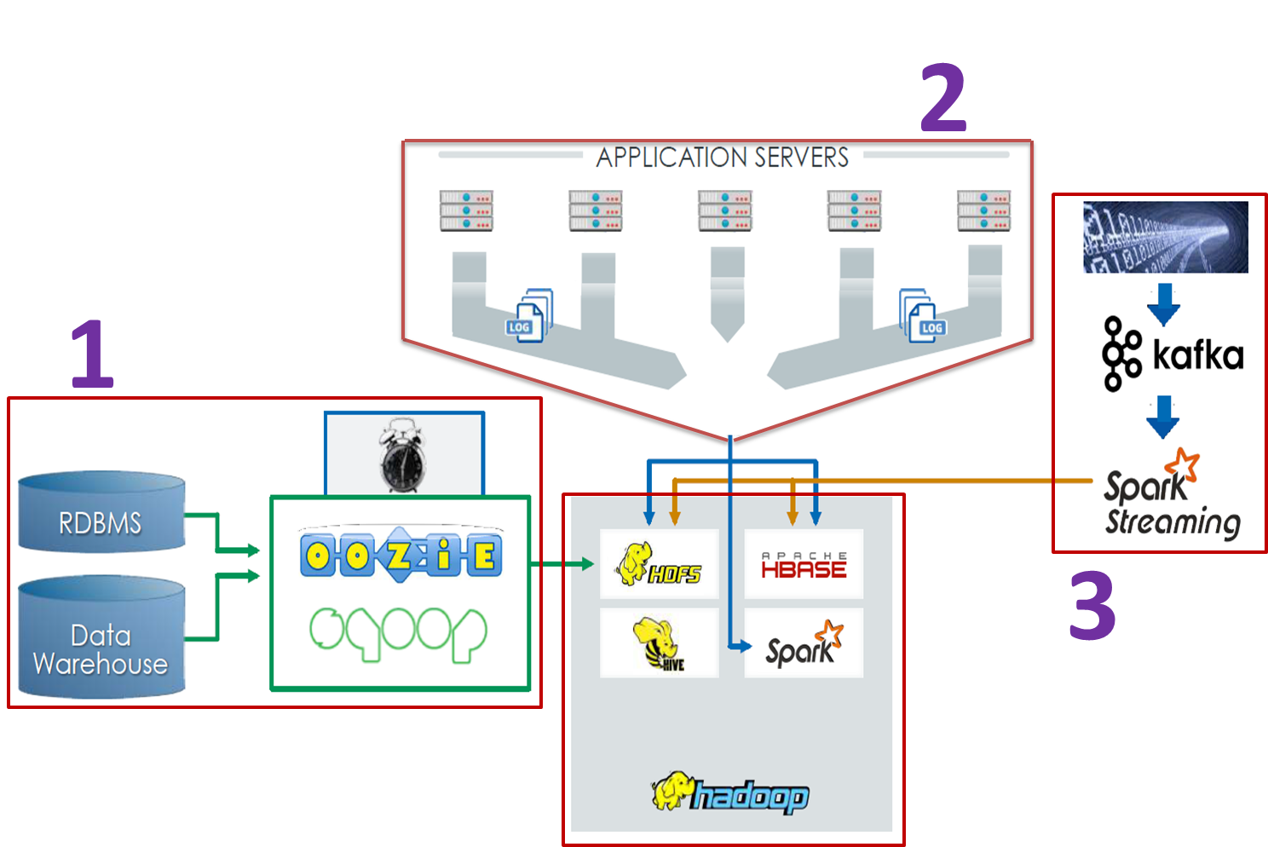
Ingestion - Design
Copyright 2016 Bloomberg L.P. All rights reserved.

Slide 21
Ingestion/Preparation Pipeline – Overview
External Data
Machine1
Gateway Machines
Internal Databases
Machine1
Internal Files
Hadoop Cluster
Copyright 2016 Bloomberg L.P. All rights reserved.

Slide 22
Ingestion Pipeline – DMZ Gateway Flow
HDFS Upload
HDFS
Cluster-1
Target-1
Watch Folder
Prepare
Upload
Finalize
Create Hard Link
If upload fails
Ingestion Workflow 1
Source
Watch Folder
Target-1
Failed Folder
Files From
external source
Ingestion Workflow 2
Create Hard Link
Target-2
Watch Folder
Prepare
Upload
Finalize
If upload fails
HDFS
Cluster-2
Target-1
Failed Folder
HDFS Upload
Synchronous
Asynchronous
Copyright 2016 Bloomberg L.P. All rights reserved.

Slide 23
Ingestion/ML Pipeline – Work Flow
Raw Data
File-1
Define Batch
File-2
Configs
File-3
…
Parse
Plugin
Batch Consistency
Execute in a Batch
Normalize/transform
Plugin
HDFS Spark Pipeline
Write to
Parquet
Plugin
Dataset-1 (avro files)
Schema
Processing Date-1
Processing Date-2
Batch-1
Store by Batch
Batch-2
File-1
File-2
Copyright 2016 Bloomberg L.P. All rights reserved.

Slide 24
Technologies –
Scala (Functional programming Paradigm)
Akka
Camel
SBT
Apache Spark
Artifactory
Oozie
Copyright 2016 Bloomberg L.P. All rights reserved.

Slide 25
Accessing
and
Using Data
Copyright 2016 Bloomberg L.P. All rights reserved.

Slide 26
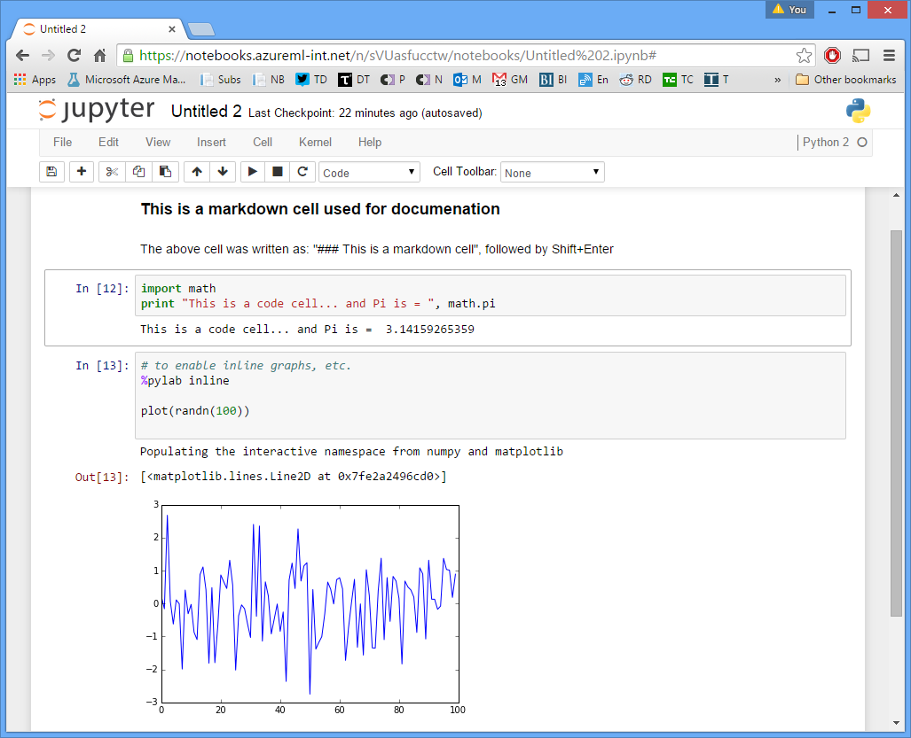
Data Science -
DMZ Notebook Infrastructure for Data Science
Web-based
Scala/Python libraries
Templates
Security and login integration
Data discovery
Enhanced SQL support
Integration with external DBs
*** Contribute back to Open-Source
Copyright 2016 Bloomberg L.P. All rights reserved.

Slide 27
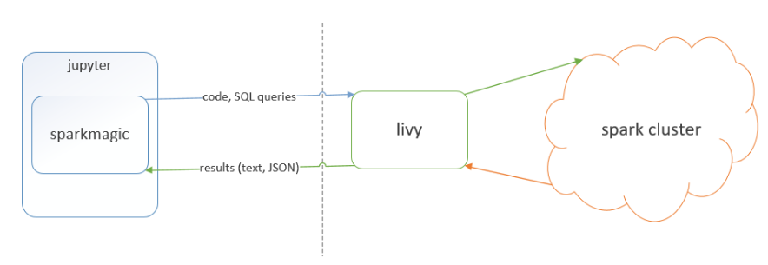
Notebook Integration Design -
DMZ
Hadoop Platform
Technologies using -
Jupyter-Hub
Kerberos
Spark kernel
Livy
HDP
Copyright 2016 Bloomberg L.P. All rights reserved.

Slide 28

Copyright 2016 Bloomberg L.P. All rights reserved.

Slide 29
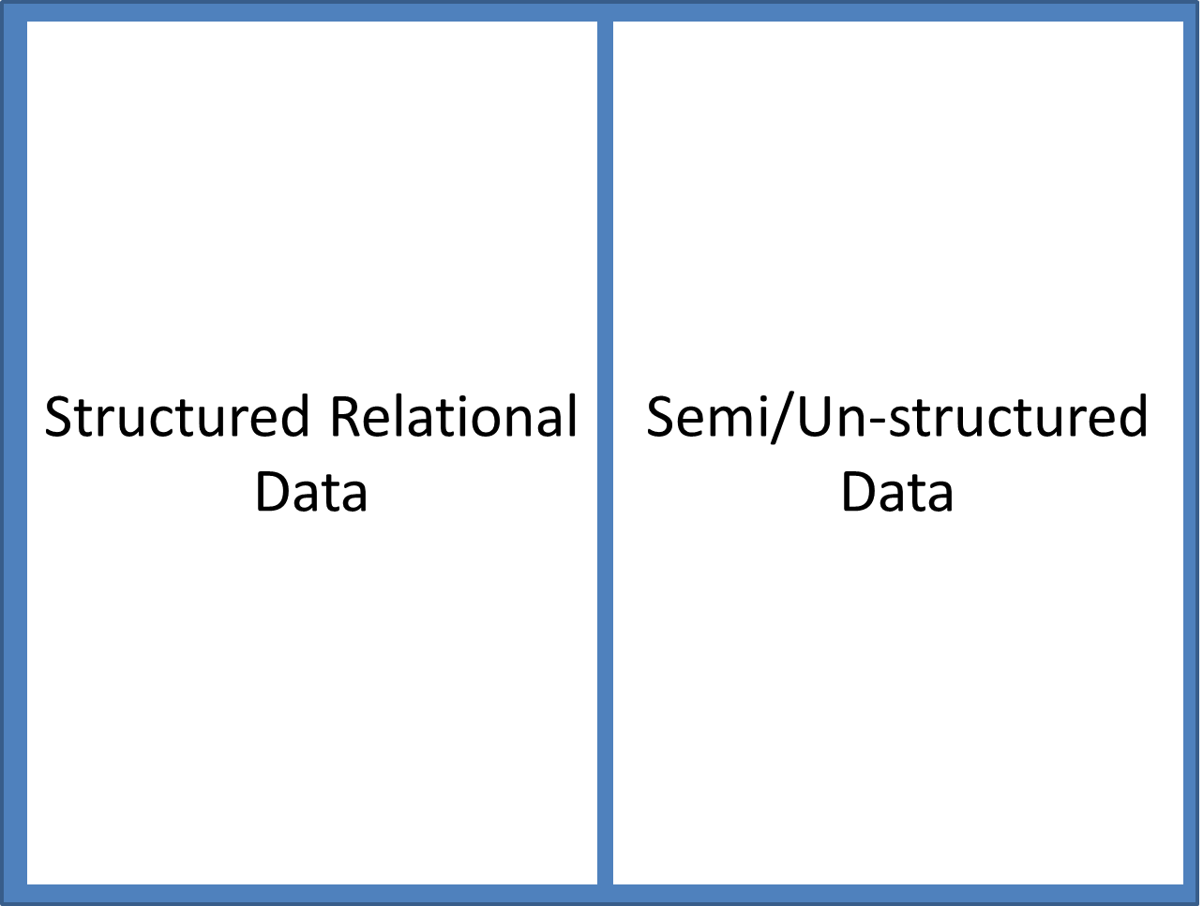
Data
Copyright 2016 Bloomberg L.P. All rights reserved.

Slide 30
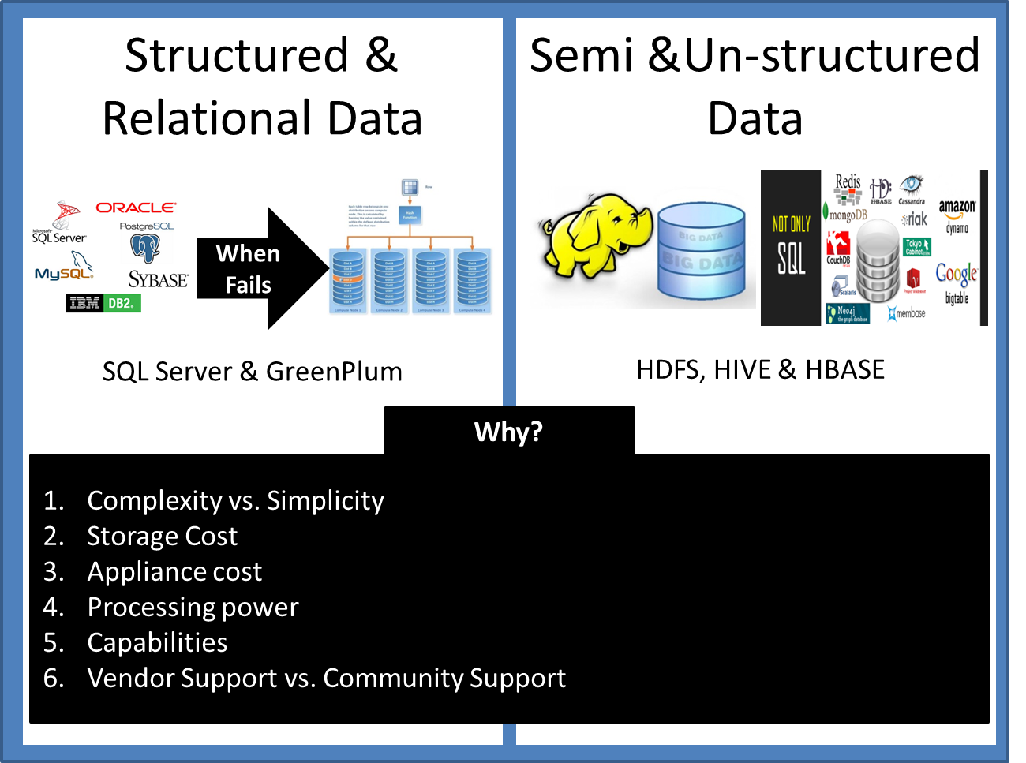
What is Big Data?
Copyright 2016 Bloomberg L.P. All rights reserved.

Slide 31
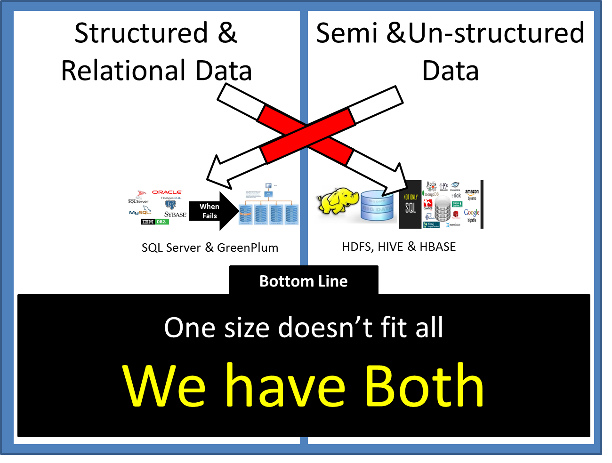
What is Big Data?
Copyright 2016 Bloomberg L.P. All rights reserved.

Slide 32
RDBMS vs. Hadoop vs. MPP
 | RDBMS | Hadoop | MPP
Data Size | Gigabytes to Terabytes | Terabytes to Hexabytes | Terabytes to Hexabytes
Access | Interactive and Batch | Batch (MapReduce) | Batch
Updates | Read and write many times | Write once, read many times | Read and write many times
Data Structure | Static Schema | Dynamic Schema | Static Schema
Data Type | Structured | Unstructured/Semi-structured | Structured
Data Integrity | High (ACID) | Low (BASE) | High (ACID)
Scaling | Non-linear | Linear | Non-linear
Support for Joins | Fully supported | Limited Support | Fully supported
Cost ($) | Medium to high | Low | High to very high
Source: en.wikipedia.org/wiki/Greenplum; www.hadoop.apache.org
Copyright 2016 Bloomberg L.P. All rights reserved.

Slide 33

Copyright 2016 Bloomberg L.P. All rights reserved.

Slide 34
Challenges
Data Security
Data reliability
Scalability
Volume
Data Validation
Data Lineage
Copyright 2016 Bloomberg L.P. All rights reserved.

Slide 35

Data Validation?
Compare Real-time Statistics with Historical data
Calculate Delta
Gateway Machines
Hadoop Cluster
Local Storage
Sync
HDFS Storage
Collect Statistics
Collect (Statistics +
rule based exceptions)
Log files
Avro Files
Raw Files
Process Files
Upload
Process Files
Copyright 2016 Bloomberg L.P. All rights reserved.

Slide 36
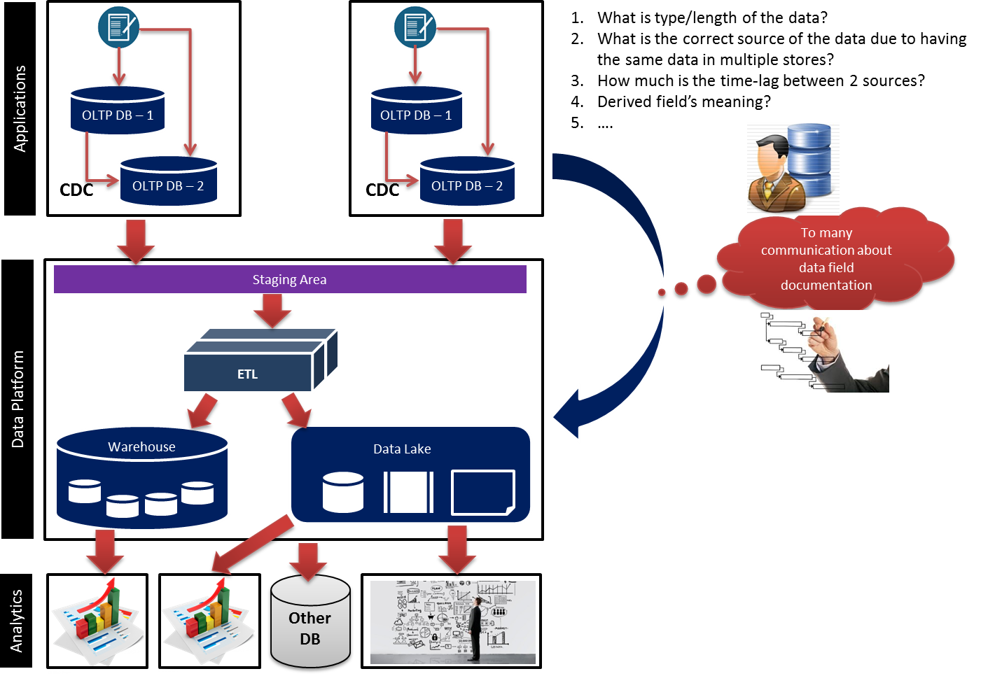
Meta Data Management
Copyright 2016 Bloomberg L.P. All rights reserved.

Slide 37
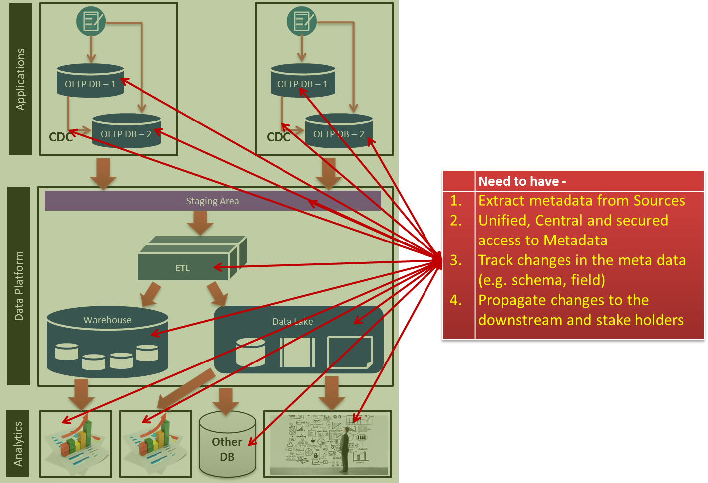
Meta Data Management
Copyright 2016 Bloomberg L.P. All rights reserved.

Slide 38
Q & A
Copyright 2016 Bloomberg L.P. All rights reserved.

Slide 39
Thank you for your time !!!
Contact - jchakrabort5@bloomberg.net
Copyright 2016 Bloomberg L.P. All rights reserved.

